Slide 1
Exploring Trajectory Prediction through Deep Learning Methods
Batch: CSEMPBNUM_L16

Slide 2
Contents
ABSTRACT
INTRODUCTION
EXISTING SYSTEM
PROPOSED SYSTEM
LITERATURE SURVEY
SOFTWARE REQUIREMENTS
HARDWARE REQUIREMENTS
OVERVIEW OF TECHNOLOGIES
DATASET
MODULES
UML DIAGRAMS
CONCLUSION
REFERENCES

Slide 3
abstract
Human mobility prediction is of great importance in a wide range of modern applications in different fields such as personalized recommendation systems, the fifth-generation (5G) mobile communication systems, and so on.
For the applications including resource allocation and mobility management, it is essential to predict the positions of mobile users in the near future from dozens of seconds to a few minutes so as to make preparation in advance.
In this paper, with the particular focus on multi-user multi-step trajectory prediction, we first design a basic deep learning-based prediction framework, where the long short-term memory (LSTM) network is directly applied as the most critical component to learn user-specific mobility pattern from the user's historical trajectories and predict his/her movement trends in the future. Motivated by the related findings after testifying and analyzing this basic framework on a model-based dataset, we extend it to a region-oriented prediction scheme and propose a multi-user multi-step trajectory prediction framework by further incorporating the sequence-to-sequence (Seq2Seq) learning.
The experimental results on a realistic dataset demonstrate that the proposed framework has significant improvements on generalization ability and reduces error-accumulation effect for multi-step prediction.

Slide 4
Introduction
Increasing pervasive usage of smart-phones and location-based services around the world has contributed to vast and rapid growth in mobility data. The large size of mobility data provides new opportunities for discovering the characteristics of human mobility patterns and making mobility predictions. Practically, human mobility prediction is of great importance in a wide range of modern applications, ranging from personalized recommendation systems to intelligent transportation, urban planning, and mobility management in mobile communication system.
Generally, the prediction goal varies from different application scenarios. For the case of 5G mobile communications, it is essential to predict the positions of mobile users in the near future from dozens of seconds to a few minutes so as to prepare for mobility management and resource allocation . It is actually a trajectory prediction problem where the trajectory refers to a time series of positions with a fixed sampling time interval between each other.

Slide 5
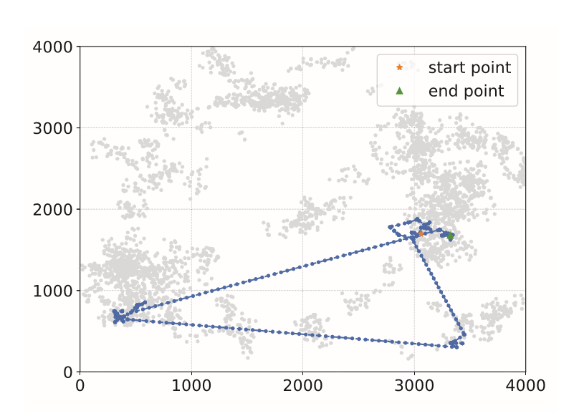
In this paper we are describing concept to predict next location of single or multiple users by training trajectories i.e., latitude and longitude of their previous locations using RNN (Recurrent Neural Networks) advance version called LSTM (Long-Term Short-Term Memory) and Seq2Seq (sequence to sequences) algorithms. Predicting location of users plays an important role for 5G Internet networks as network service providers need to allocate nearest resources (cloud servers who take users mobile heavy computation task and process that request and send result back to mobile, if nearest cloud allocate to user then response will be faster and this nearest allocation can be done if users next locations can be predicted) to users to process their mobile request data. We have considered the use of deep learning methods such as Extreme Learning machine which have a promising result in the decrement of errors and which can be proved to be one of the most optimal algorithms to provide us with the best of results.

Slide 6
Existing System
In this paper takes comprehensive investigation for the approaches to predict trajectories composed of continuous coordinates. Since it is actually a time series regression prediction problem, conventional regression algorithms such as linear regression and support vector regression (SVR) are candidate solutions.
However, the mobility trajectories are usually short sequences composed of two-dimensional coordinates reflecting geographic locations, making Linear Regression and SVR possibly not competent to the trajectory prediction problem.

Slide 7
Proposed System
Within the framework of deep learning, the work in applies LSTM to trajectory prediction for vehicles on highway. However, the proposed method is specifically designed for the highway scenario and requires complex external features, including position and velocity of surrounding vehicles, which restricts its general applicability. Hence, the proposed system is a social LSTM network for pedestrian trajectory prediction .
Therefore, we assume the long- short term memory (LSTM) and Extreme Learning Machine (ELM) to predict the trend of user movements in each cell from trajectories composed of discrete cells and we evaluate the prediction performance of the proposed framework on a user’s trajectories from the model-based dataset.

Slide 8
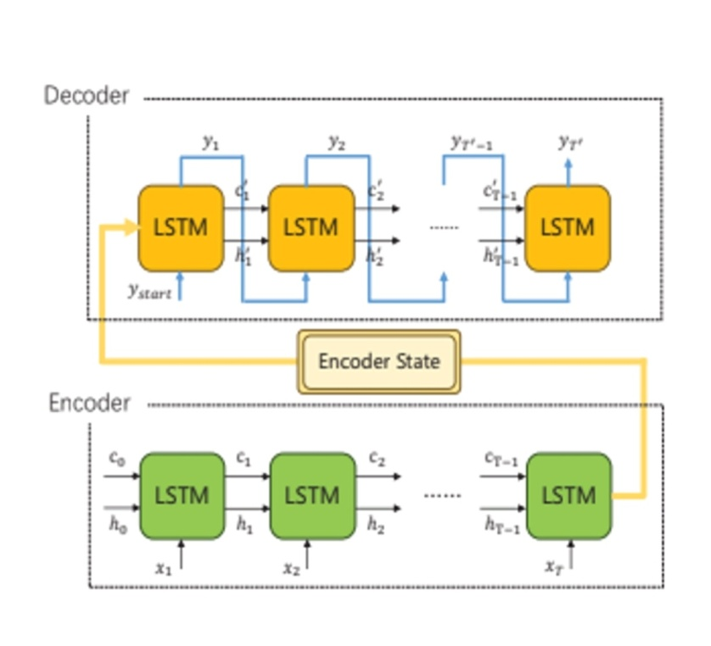
LONG SHORT- TERM MEMORY
Recurrent Neural Networks suffer from short-term memory. If a sequence is long enough, they’ll have a hard time carrying information from earlier time steps to later ones. So, if you are trying to process a paragraph of text to do predictions, RNN’s may leave out important information from the beginning. During back propagation, recurrent neural networks suffer from the vanishing gradient problem. Gradients are values used to update a neural networks weight. The vanishing gradient problem is when the gradient shrinks as it back propagates through time. If a gradient value becomes extremely small, it doesn’t contribute too much learning.
LSTM ’s was created as the solution to short-term memory. They have internal mechanisms called gates that can regulate the flow of information
Different Components And Workflow Of LSTM

Slide 9
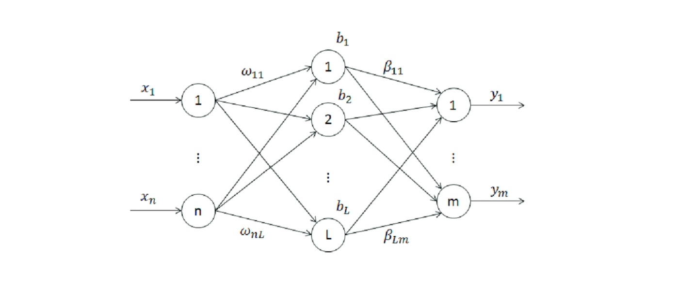
Extreme learning machine
Extreme Learning Machine (ELM) is a novel method for pattern classification as well as function approximation. This method is essentially a single feedforward neural network; its structure consists of a single layer of hidden nodes, where the weights between inputs and hidden nodes are randomly assigned and remain constant during training and predicting phases. On the contrary, the weights that connect hidden nodes to outputs can be trained very fast. Experimental studies in the literature showed that ELMs can produce acceptable predictive performance and their computational cost is much lower than networks trained by the back-propagation algorithm.
Network Structure Of Extreme Learning Machine

Slide 10
Literature survey
Trajectory prediction is a very demanding process for many fields of work, these include travel companies, geographic companies, department of police etc. our work is based of the paper “Exploring Trajectory Predictions using Machine Learning Methods”, published by Chujie Wang, Lin Ma, Rongpeng Li, Tariq S. Durrani, and Honggang Zhang. The authors of the base paper have utilized simpler methods such as Linear regression and Support Vector Regression. Although researchers have proposed many mobility prediction methods, such as frequent patterns mining, Markov-based models and other machine learning methods, most of these methods are dedicated to discrete location prediction, which is actually a multi-classiﬁcation problem, and not suitable for predicting trajectories with ﬁxed sampling time intervals.
With the advances in deep learning, more optimal methods have come into light which provide better results and cover up discrepancies from the other simpler algorithms. Within the framework of deep learning, the Recurrent Neural Network (RNN) has proved its superiority in various time series problems not only in natural language processing ﬁeld (i.e. machine translation, speech recognition) but also some other ﬁelds (i.e. trafﬁc prediction, precipitation prediction). Therefore, as the improved versions of typical RNN, Long-Term Short-Term Memory (LSTM) and Extreme Learning Machine (ELM) which are promising algorithms for the trajectory prediction problem. However, the proposed method is speciﬁcally designed for the highway scenario and requires complex external features, including position and velocity of surrounding vehicles, which restricts its general applicability.

Slide 11
Literature survey
Within the framework of deep learning, the work in applies LSTM to trajectory prediction for vehicles on highway. However, the proposed method is speciﬁcally designed for the highway scenario and requires complex external features, including position and velocity of surrounding vehicles, which restricts its general applicability. Alahi el al. proposed a social LSTM network for pedestrian trajectory prediction. However, it can only predict human trajectories through static images under a speciﬁc small range scene such as hotels and intersections. Feng et al. proposed a Deep Move model which combines the GRU network with the attention mechanism to predict future discrete locations from long-range and sparse trajectories. However, its prediction accuracy can only reach 59.3% in cellular network scenarios since it is difﬁcult to capture the trend of user movements in each cell from trajectories composed of discrete cells. We establish a Seq2Seq framework based on the LSTM encoder-decoder architecture to capture the temporal association within the trajectory like speed or direction. All trajectories in the speciﬁc area are utilized for the network to acquire the shared short-term mobility patterns caused by geographical constraints. Multi-user multi-step prediction promises to bring lots of signiﬁcant merits. Firstly, it allows for more practical nearreal-time resource pre-allocation. But it has to deal with the annoying error-accumulation effect. Secondly, the generalization ability of the prediction model across users also makes it feasible to quickly perform trajectory prediction for any user. Thirdly, the computation overhead of training a model for each user separately can be signiﬁcantly reduced. Therefore, we consider the real-world user movement scenario and propose a multi-user multi-step trajectory prediction framework.

Slide 12
Literature survery
Extreme learning machine (ELM) is a new learning algorithm for the single hidden layer feed-forward neural networks. They are feed-forward neural networks for classification, regression, clustering, sparse approximation, compression and feature learning with a single layer or multiple layers of hidden nodes, where the parameters of hidden nodes (not just the weights connecting inputs to hidden nodes) need not be tuned. These hidden nodes can be randomly assigned and never updated (i.e. they are random projection but with nonlinear transforms), or can be inherited from their ancestors without being changed. In most cases, the output weights of hidden nodes are usually learned in a single step, which essentially amounts to learning a linear model. Compared with the conventional neural network learning algorithm it overcomes the slow training speed and over-fitting problems and ELM is based on empirical risk

Slide 13
Software requirements
HOSTING ENVIRONMENT :
Operating System: Windows 7 or later, Mac OS 10.9 or later or modern Linux
Support Software: Visual Studio Code, v7 or higher, Node Js v8 or higher, Oracle 10g Express Edition, Anaconda
Browser: Google Chrome v70 or higher.
DEPLOYING ENVIRONMENT :
Operating System: Windows XP or later, Mac OS 7.0 or later or modern Linux, Anaconda, Jupyter Notebook
Recommended Browser: Google Chrome (Across All Platforms)

Slide 14
HARDWARE REQUIREMENTS
Operating System supported by
1. Windows 7
2. Windows XP
3 . Windows 8
Processor – Pentium IV or higher
RAM -- 256 MB

Slide 15
Overview of technologies
Anaconda Command Prompt is a library for prompting input on the command line for Python 3.3+. It is pure Python code with no dependencies. Anaconda command prompt is just like command prompt, but it makes sure that you are able to use anaconda and conda commands from the prompt, without having to change directories or your path. When you start Anaconda command prompt, you'll notice that it adds/("prepends") a bunch of locations to your PATH. These locations contain commands and scripts that you can run. So as long as you're in the Anaconda command prompt, you know you can use these commands.
Here are some libraries we utilized:
1. Pandas
In computer programming, pandas is a software library written for the Python programming language for data manipulation and analysis. In particular, it offers data structures and operations for manipulating numerical tables and time series. It is free software released under the three-clause BSD license. The name is derived from the term "panel data", an econometrics term for data sets that include observations over multiple time periods for the same individuals.

Slide 16
2. NUMPY
NumPy is a library for the Python programming language, adding support for large, multidimensional arrays and matrices, along with a large collection of high-level mathematical functions to operate on these arrays. The ancestor of NumPy, Numeric, was originally created by Jim Hugunin with contributions from several other developers. In 2005, Travis Oliphant created NumPy by incorporating features of the competing Numarray into Numeric, with extensive modifications. NumPy is open-source software and has many contributors.
3. MATPLOTLIB
Matplotlib is a plotting library for the Python programming language and its numerical mathematics extension NumPy. It provides an object-oriented API for embedding plots into applications using general-purpose GUI toolkits like Tkinter, wxPython, Qt, or GTK+. There is also a procedural "pylab" interface based on a state machine (like OpenGL), designed to closely resemble that of MATLAB, though its use is discouraged. SciPy makes use of Matplotlib.
4. SKLEARN
Scikit-learn (formerly scikits.learn and also known as sklearn) is a free software machine learning library for the Python programming language. It features various classification, regression and clustering algorithms including support vector machines, random forests, gradient boosting, k-means and DBSCAN, and is designed to interoperate with the Python numerical and scientific libraries NumPy and SciPy.

Slide 17
Dataset
In order to evaluate the performance of the mobility prediction framework, we adopt two types of datasets (i.e., a model-based dataset and a realistic dataset) for the reasons as follows. Given the strong randomness of user mobility, it is necessary to testify the performance of a proposed algorithm in a realistic environment. But considering that a realistic dataset is often collected in a user-voluntary manner, the dataset usually consists of user mobility trajectories lasting short duration and possessing irregular starting and ending time. Hence, we generate a model-based dataset from well-known models to assist in ﬁnding some intuitive guidance.
We utilize a large real-life GPS trajectory dataset from the Geolife project of Microsoft Research Asia. The dataset was collected by 182 users, containing 18,670 trajectories with various sampling rates. Each trajectory is represented by a series of time stamp points with latitude and longitude coordinates recorded by GPS-functioned phones. As an essential work for a large and messy raw dataset, we take the following preprocessing steps.

Slide 18
Modules
Importing Dataset Module: In this module, we import the trajectory model based dataset
Generating the model Module: In this module, we perform the generating of the LSTM model
Training the model: The LSTM model is trained with seq2seq.
Predicting Trajectory: This model presents a prompt which asks the latitude and longitude of the given user to try and predict the next location.

Slide 19
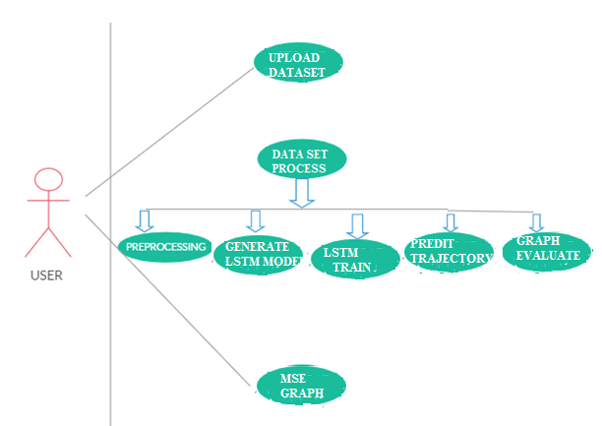
UML Diagrams
Use case Diagram:

Slide 20
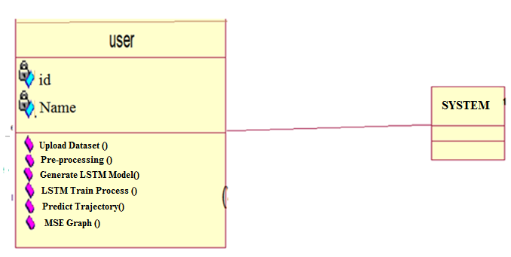
Class Diagram:

Slide 21
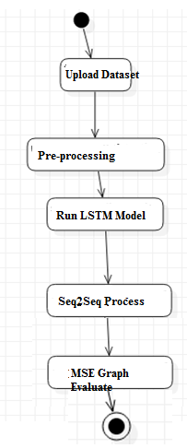
Activity Diagram:

Slide 22
Output Screenshots
The multi user model includes data from multiple users. Thus, the prepared dataset include data from multiple user folders of the original geolife project dataset. The project code is developed in the python .py file. Therefore, the code is executed in the command prompt. The functions use TensorFlow modules to create deep neural network model for the multi user purpose.
During execution the main function invokes all the function calls in it. The upload function accesses the dataset file present in the specified location. Then it opens up the data present in dataset file under read access. The dataset is loaded into a variable and a list is prepared for further use.
Running code file and dataset upload

Slide 23
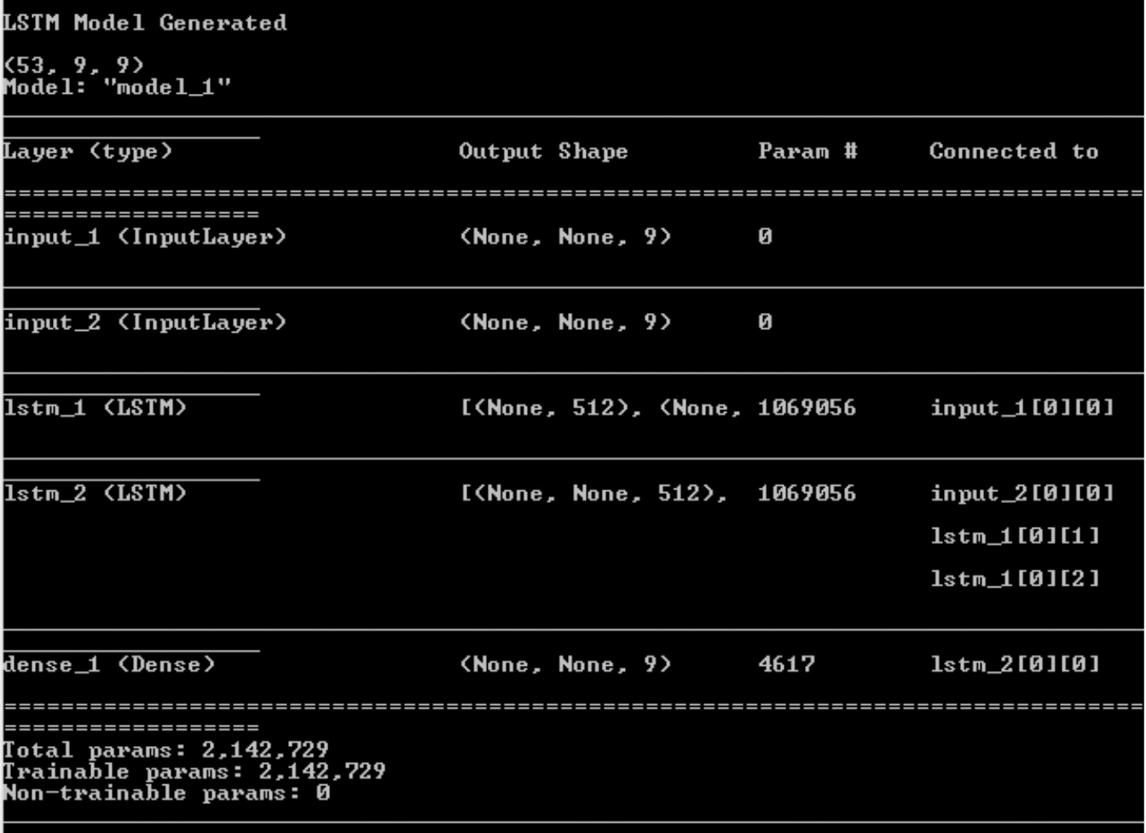
Lstm model generation and the model attributes
Now the function LSTM model is invoked in order to generate a LSTM (Long Short-Term Memory) model. This model is a deep neural network model that is designed to guide the process to the users next location. Thus, the model consists of some input, output and dense layers.

Slide 24
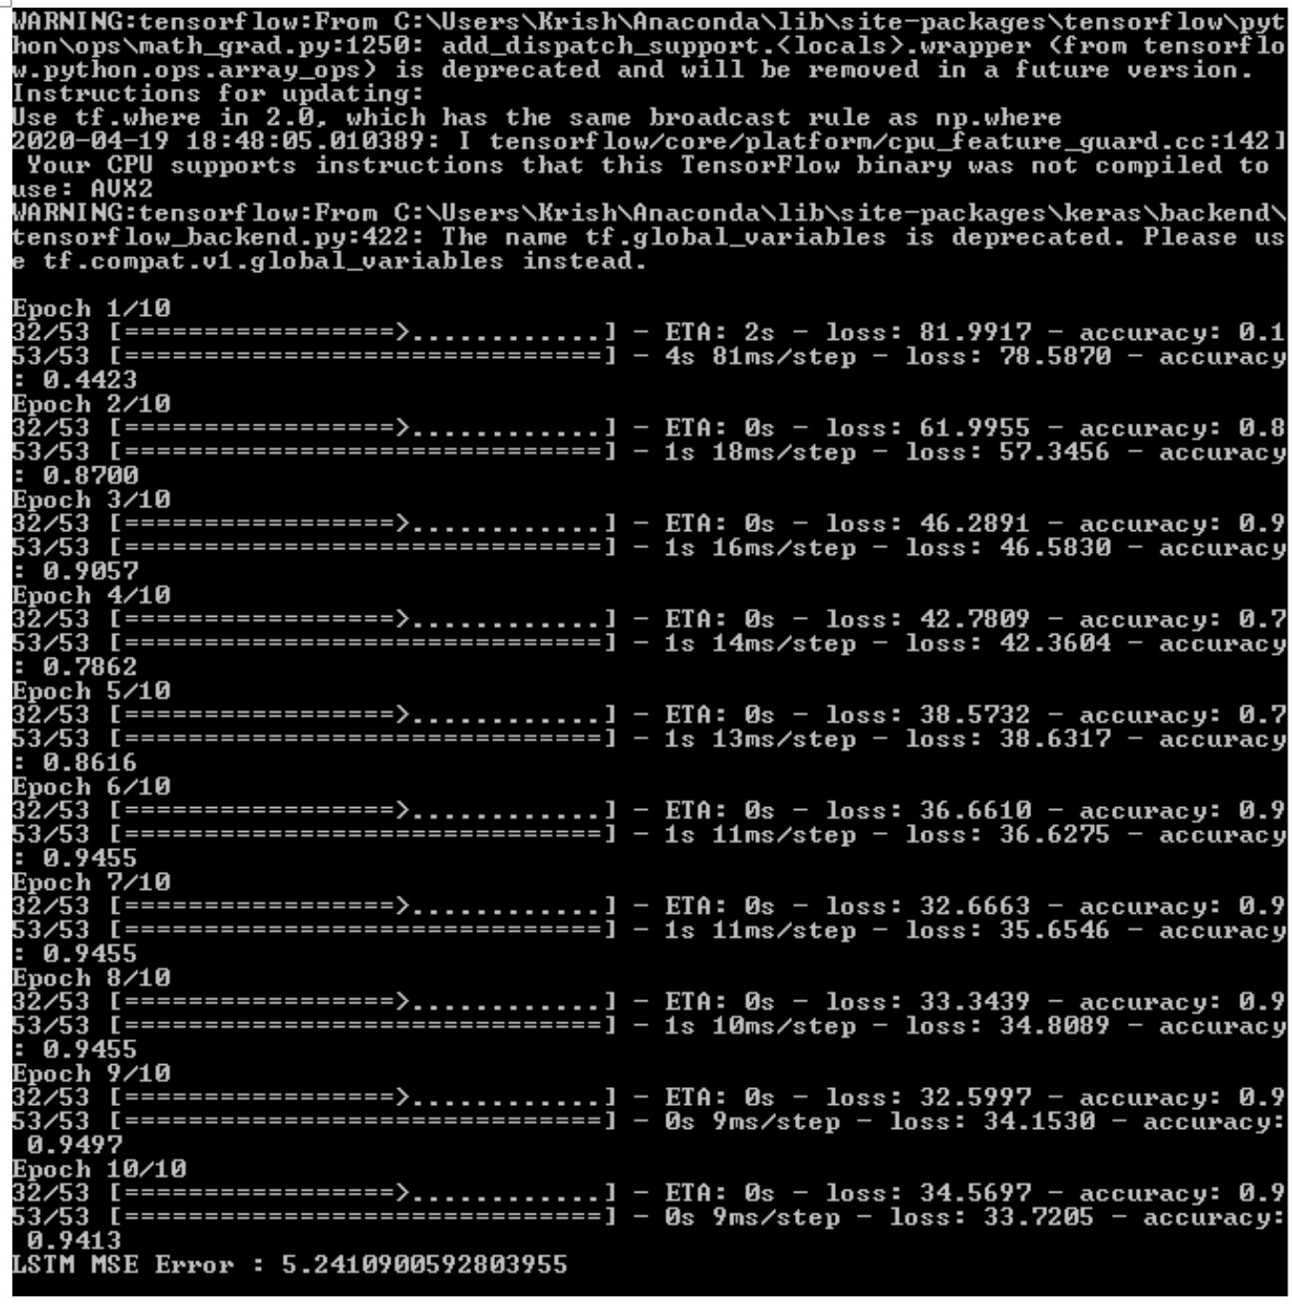
TRAINING THE LSTM MODEL WITH EPOCHS FOR BETTER RESULTS
The model generation is complete thus we train the model with the dataset that we have prepared which fits suitable for the project. The model is made up with encoders and decoders the idea behind the LSTM algorithm. The dataset in a csv file is passed on to the model and the list prepared in the beginning which consists of the values of dataset in a list format. All these resources are used in a processed way to train the model. And a certain number of epochs are run while training the model. The metrics for the epoch are also displayed accordingly. And certain metrics like accuracy and MSE values are calculated.

Slide 25
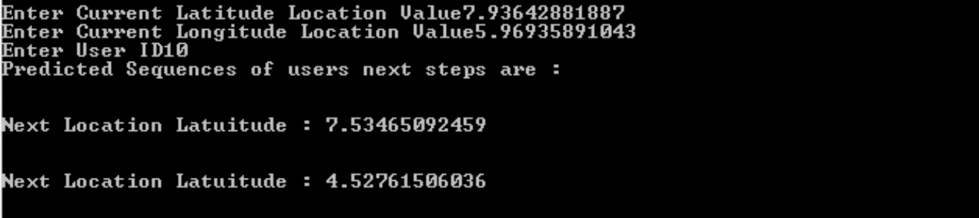
PREDICTING USER NEXT LOCATION
This function is to predict the next location user using LSTM model created. The function requests for certain values of the user like longitude, latitude and user id. By providing those values to the model we predict the next location of the user. The model passes the data through the network created and predicts the next values.

Slide 26
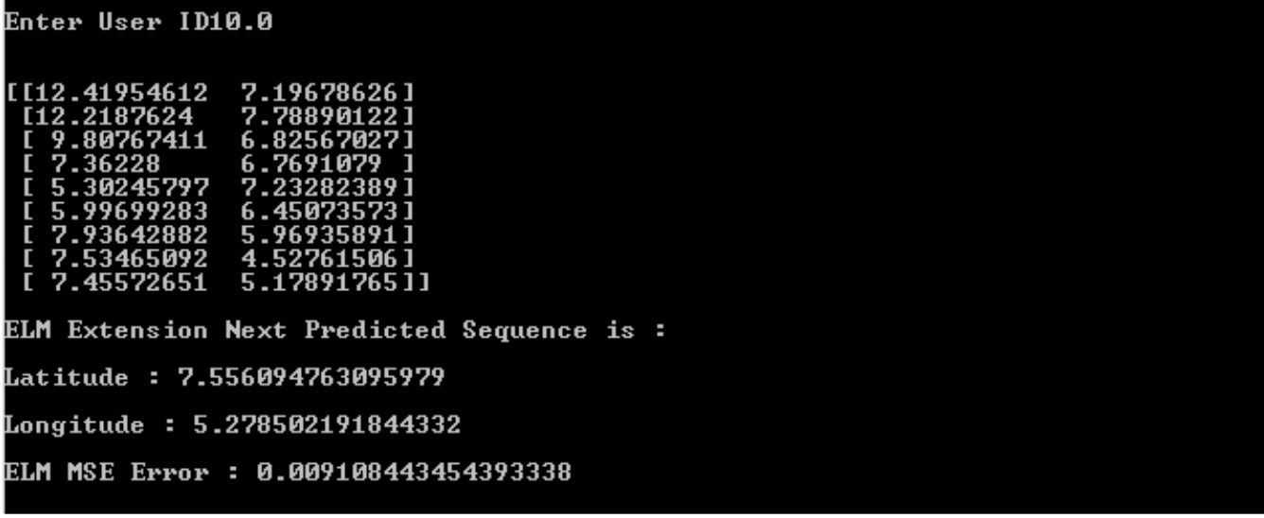
EML regression model and new location prediction
The function we have invoked works on creating a model for EML regression algorithm. And this model helps us in predicting the next location of a particular user after all the user location points are trained. The model prepares a new location values which point to values that are potentially the next location after users last location. The function takes user id as input and training data is shown to know the latitude and longitude values. And displays finally calculated new location values.

Slide 27
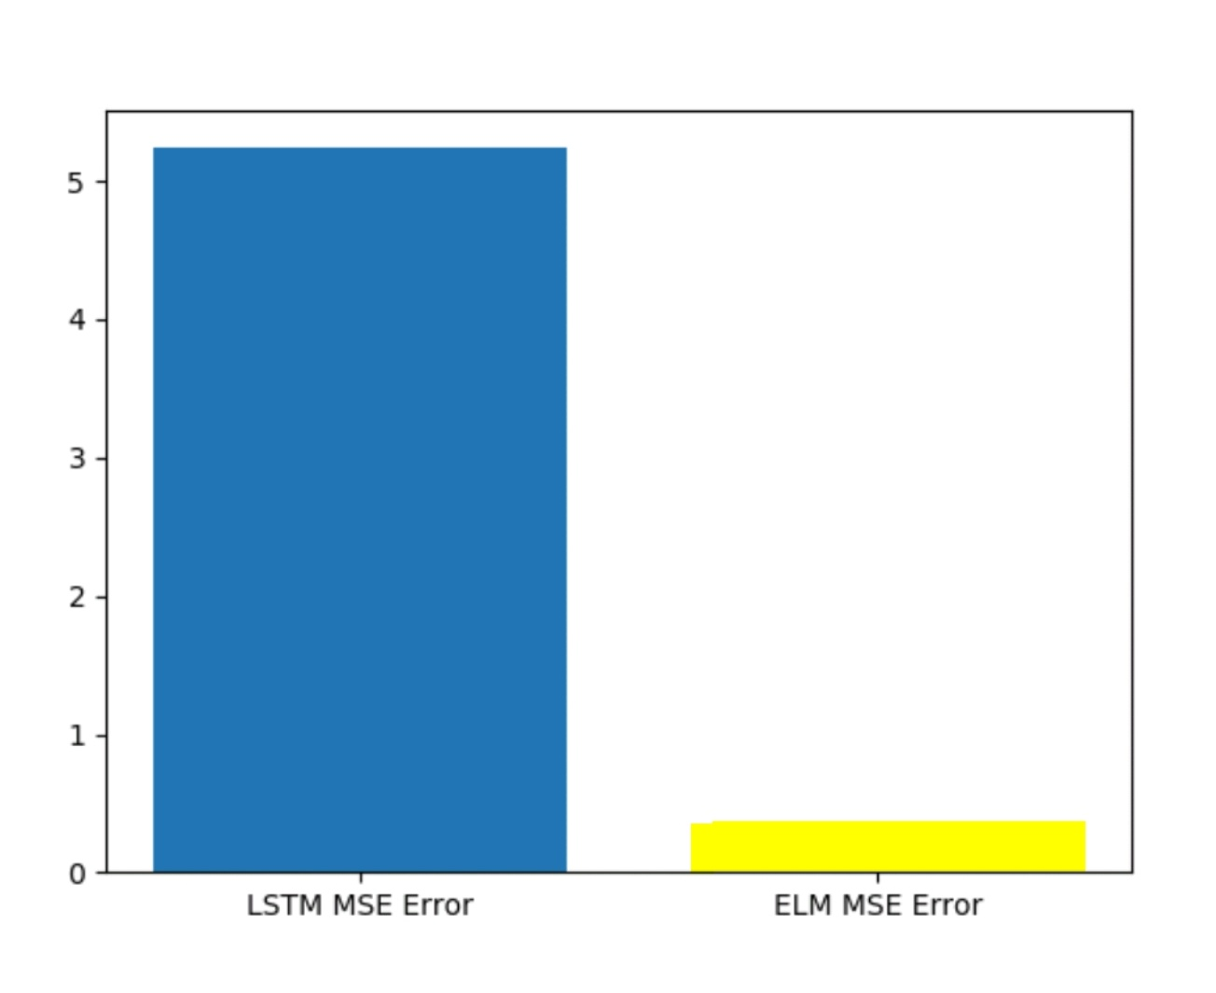
Graphical representation of comparison
In the adjacent graph we can see with LSTM more prediction error is there on comparison with ELM. In above graph x-axis contains algorithm name and y-axis contains error rate. This graph proves that Extreme learning machine has an advantage over the LSTM.

Slide 28
Conclusion
In this paper, we investigate the significance of trajectory prediction and explore feasible approaches from both the single-user perspective and multi-user perspective. For single-user trajectory prediction, we propose a basic LSTM framework and experimental results on a model-based mobility dataset illustrate the superiority of LSTM to make predictions based on pre-learning of user-specific mobility patterns. For multi-user multi-step prediction, we further propose a region-oriented prediction scheme and put forward an LSTM-based Seq2Seq framework. Experiments on a realistic dataset show that the proposed framework outperforms the other competing approaches, which demonstrate its outstanding generalization ability for multi-user prediction as well as robustness and stability for multi-step prediction. Our current work does not consider the semantic context in the trajectory like the point of interests because of the limitation of data. For future work, we plan to combine our algorithm with some semantic information to improve the prediction performance.
Though, the aforementioned experimental results have shown the superiority of basic LSTM framework for learning user-speciﬁc mobility pattern, there still exist several issues to address for practical applications. First is the poor generalization ability of the proposed user speciﬁc mobility model. Usually, it is necessary to predict the trajectories of multi-users simultaneously in practical applications. Therefore, we need to train speciﬁc prediction models for each user of interest, which is not a sensible approach. On one hand, it incurs large computation overhead. On the other hand, training such a model usually needs a lot of historical data of the user, leading to cold start problem for users with insufﬁcient training data. Second is the error-accumulation effect for multi-step prediction. When the position measurements are suspended, the prediction is rapidly unable to follow the actual evolution of trajectory accurately, resulting in negative impacts on practical applications

Slide 29
References
A : CONFERENCE PROCEEDINGS
Z. Kai, S. Tarkoma, S. Liu, and H. Vo, “Urban human mobility data mining: An overview,” in IEEE International Conference on Big Data, 2017.
C. Yao, J. Guo, and C. Yang, “Achieving high throughput with predictive resource allocation,” in 2016 IEEE Global Conference on Signal and Information Processing (GlobalSIP). IEEE, 2016, pp. 768–772.
B. D. Ziebart, A. L. Maas, A. K. Dey, and J. A. Bagnell, “Navigate like a cabbie: Probabilistic reasoning from observed context-aware behavior,” in Proceedings of the 10th International Conference on Ubiquitous Computing. ACM, 2008, pp. 322–331.
M. Morzy, “Mining frequent trajectories of moving objects for location prediction,” in Machine Learning and Data Mining in Pattern Recognition. Berlin, Heidelberg: Springer Berlin Heidelberg, 2007, pp. 667– 680.
A. Graves and N. Jaitly, “Towards end-to-end speech recognition with recurrent neural networks,” in International Conference on Machine Learning, 2014, pp. 1764–1772.
C. Zhang and P. Patras, “Long-term mobile trafﬁc forecasting using deep spatio-temporal neural networks,” in Proc. MOBIHOC 2018, Los Angeles, USA, Jun. 2018.
X. SHI, Z. Chen, H. Wang, D.-Y. Yeung, W.-k. Wong, and W.-c. WOO, “Convolutional LSTM network: A machine learning approach for precipitation now casting,” in Advances in Neural Information Processing Systems 28, C. Cortes, N. D. Lawrence, D. D. Lee, M. Sugiyama, and R. Garnett, Eds. Curran Associates, Inc., 2015, pp. 802–810.

Slide 30
B : journal
S. Qiao, D. Shen, X. Wang, N. Han, and W. Zhu, “A self-adaptive param- eter selection trajectory prediction approach via hidden markov models,” IEEE Transactions on Intelligent Transportation Systems, vol. 16, no. 1, pp. 284–296, Feb 2015.
Q. Lv, Y. Qiao, N. Ansari, J. Liu, and J. Yang, “Big data driven hidden markov model based individual mobility prediction at points of interest,” IEEE Transactions on Vehicular Technology, vol. 66, no. 6, pp. 5204– 5216, 2017.
S. B. Cho, “Exploiting machine learning techniques for location recognition and prediction with smartphone logs,” Neurocomputing, vol. 176, pp. 98–106, 2016.
A. J. Smola and B. Sch¨ olkopf, “A tutorial on support vector regression,” Statistics and Computing, vol. 14, no. 3, pp. 199–222, 2004.
A. A. Adebiyi, A. O. Adewumi, and C. K. Ayo, “Comparison of ARIMA and artiﬁcial neural networks models for stock price prediction,” Journal of Applied Mathematics, vol. 2014, 2014.
H. Z. Moayedi and M. Masnadi-Shirazi, “ARIMA model for network trafﬁc prediction and anomaly detection,” in 2008 International Symposium on Information Technology, vol. 4. IEEE, 2008, pp. 1–6.
H. Yu and X. Zhu, “Recurrent neural network based rule sequence model for statistical machine translation,” in Proceedings of the 53rd Annual Meeting of the Association for Computational Linguistics and the 7th International Joint Conference on Natural Language Processing(Volume 2: Short Papers), vol. 2, 2015, pp. 132–138.

Slide 31
C : books
J. Neter, W. Wasserman, and M. H. Kutner, “Applied linear regression models,” 1989.

Slide 32
THANK YOU
This Project is presents by:
V. B. S. PRAHASITH 2215316259
B. KRISHNA CHAITANYA 2215316212
K. MANIDEEP 2215316228
K. MURALI KRISHNA 2215316223

